Slide 1
Emotion Filter
Name: ID
Ifty Mohammad Rezwan 1430554042

Slide 2
Human Emotion
Important aspect in machine to human transition.
Has many Applications, Education, Health, Surveillance etc.

Slide 3
Dataset
Many Choices
Some too big. E.g. Affectnet
Some too small. E.g. Jaffe
Some lack variety. E.g. CK+

Slide 4
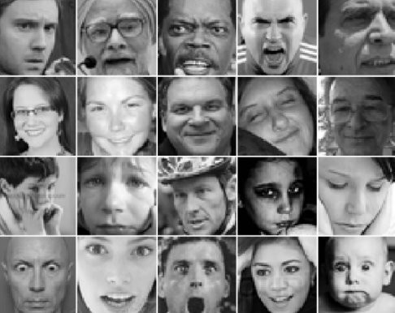
Dataset
FER 2013
Source = Kaggle
7 emotions
Around 36000 images
Variety

Slide 5
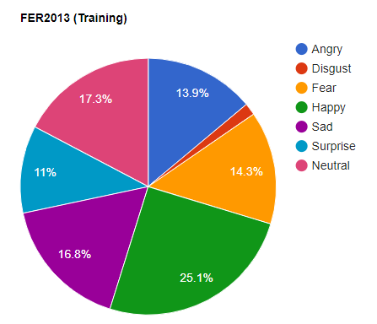
Dataset Distribution (Training)
Angry = 3995
Disgust = 0436
Fear = 4097
Happy = 7215
Sad = 4830
Surprise = 3171
Neutral = 4965

Slide 6
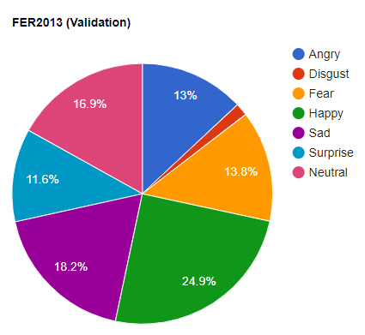
Dataset Distribution (Validation)
Angry = 467
Disgust = 056
Fear = 496
Happy = 895
Sad = 653
Surprise = 415
Neutral = 607

Slide 7
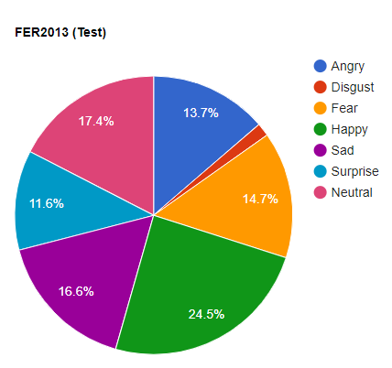
Dataset Distribution (Test)
Angry = 491
Disgust = 055
Fear = 528
Happy = 879
Sad = 594
Surprise = 416
Neutral = 626

Slide 8
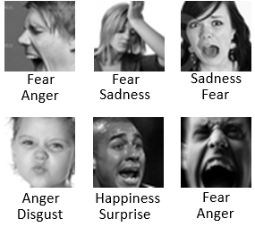
Challenges
Uneven dataset distribution.
Some faces are misclassified.
Papers using this dataset haven’t achieved more than 71.33% using shallow networks

Slide 9
Software and Libraries Used For Data Viz
Python , Pandas & Jupyter Notebook for data insight
RapidTables for PieChart
Matplotlib & Numpy for visualization.

Slide 10
Previous Literature
Y. Tang, “Deep learning using linear support vector machines,” (SVM +CNN) , Accuracy 71.2%
Y. Guo, D. Tao, J. Yu, H. Xiong, Y. Li, and D. Tao, “Deep neural networks with relativity learning for facial expression recognition” (CNN + loss layer), Accuracy 71.33%
Fer 2013,Kaggle Competition Winner used RBM and achieved 71.12%

Slide 11
Approaches
Data preprocessing
Feature Extraction through Convolutional Neural Networks
Classify through SoftMax Layer and Non Negative Likelihood.

Slide 12
Library & Language
Python (Overall Scripting)
PIL (Image Processing)
SkLearn (Image Processing & Confusion Matrix)
Pytorch (Conv Net , Softmax & Others)

Slide 13
Data Preprocessing
Random Image Flip (Horizontal and Vertical)
Image Crops

Slide 14
Difficulties with Data Preprocessing
Wrangling data to the shape Pytorch supports or wants as input
Tensor & Array Mismatch

Slide 15
Optimizer & Loss Function
Optimizer = Stochastic Gradient Descent
Loss Function = Cross Entropy Loss

Slide 16
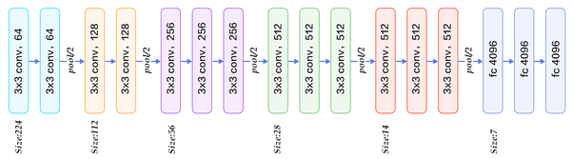
CNN (Approach 1)
Feature extractor = VGG19
Mixture of two kinds of layers
Conv layers with batchnorm and ReLU followed by maxpooling layers.
Accuracy of around 72% on the Test Dataset.

Slide 17
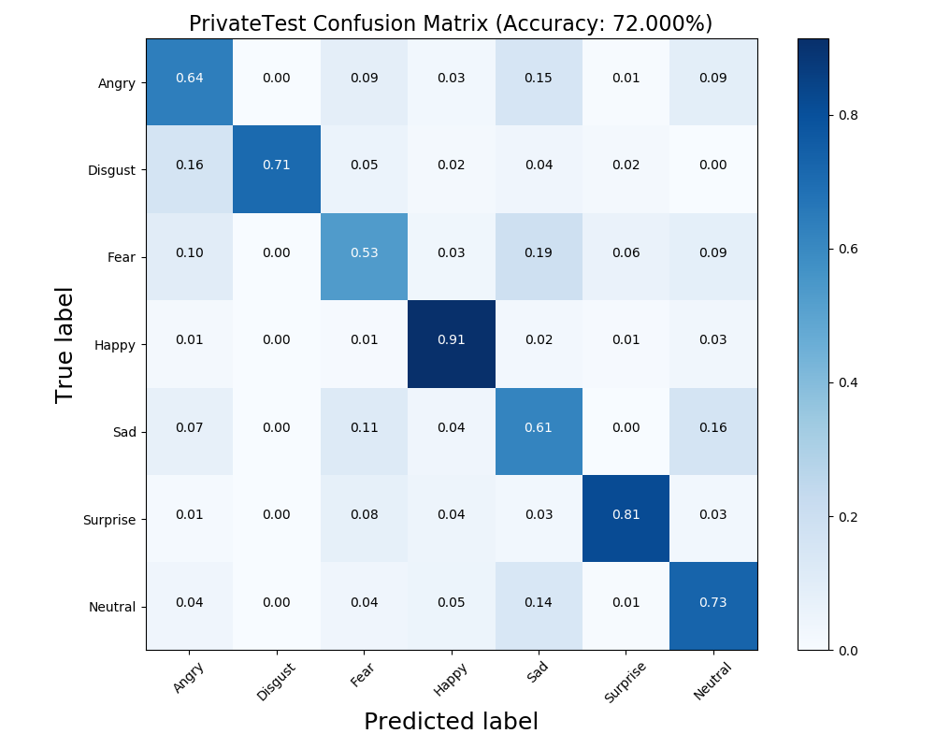
CNN (Approach 1)

Slide 18
Difficulties Faced
Setting up hyperparameters (Mostly empirical)
Channel Manipulation
Pytorch zero_grad()

Slide 19
Conclusion & Thoughts
Happy & Surprise are quite accurate while others are not.
Might be due to imbalance in the training dataset.
Anger, Disgust, Fear & Sad are quite similar. We can see the co-relations in the confusion matrix.

